Slide 1
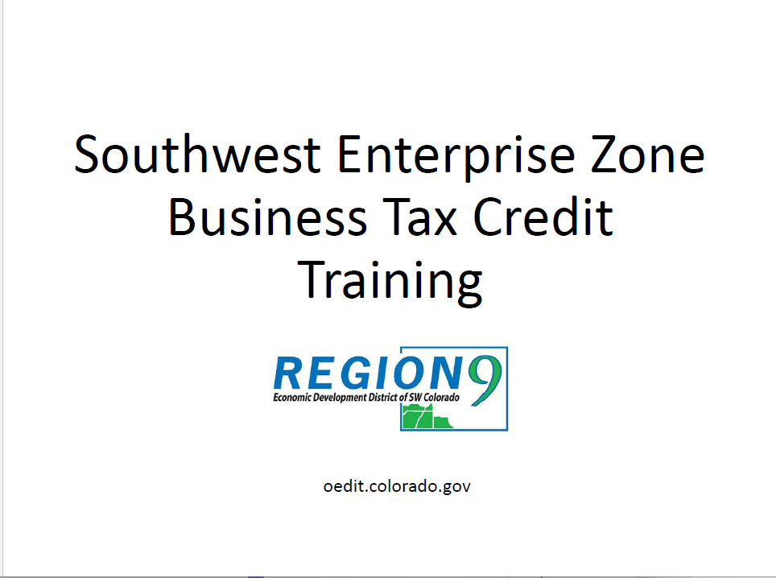



Slide 2
Overview
What is the Enterprise Zone?
Region 9 Economic Development’s role
Maps of EZ areas
Available State Tax Credits
Precertification
Certification of Credits
Brief overview of Contribution Projects
Contact Information
Questions?

Slide 3
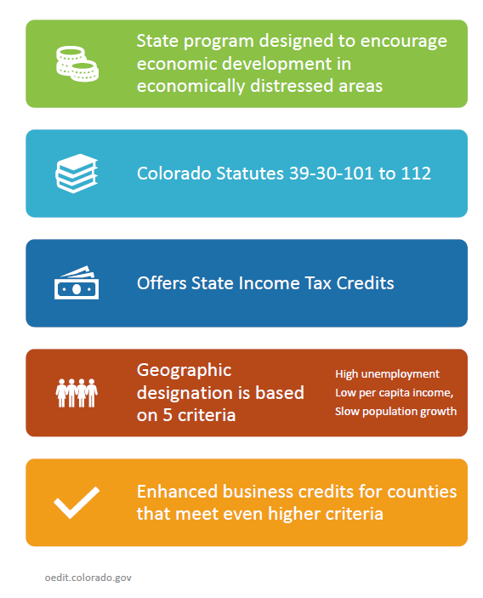
What is the Enterprise Zone (EZ)?

Slide 4
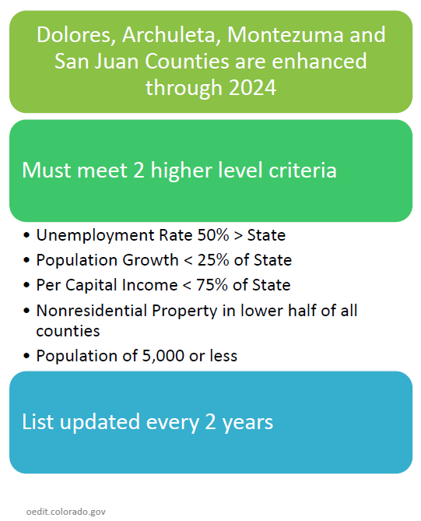
Enhanced Rural Enterprise Zone (EREZ):

Slide 5
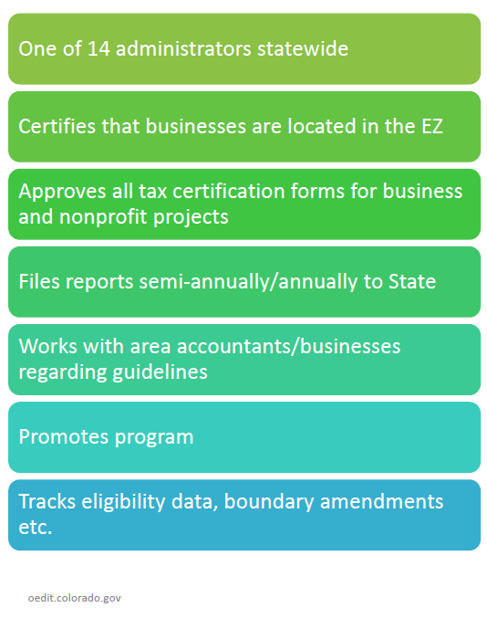
What is Region 9’s Role?

Slide 6
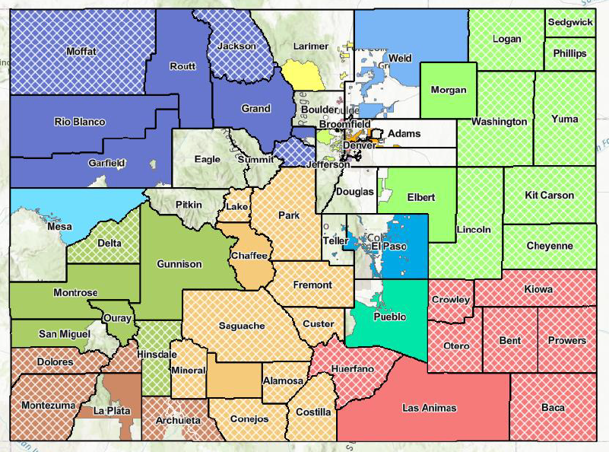

Slide 7
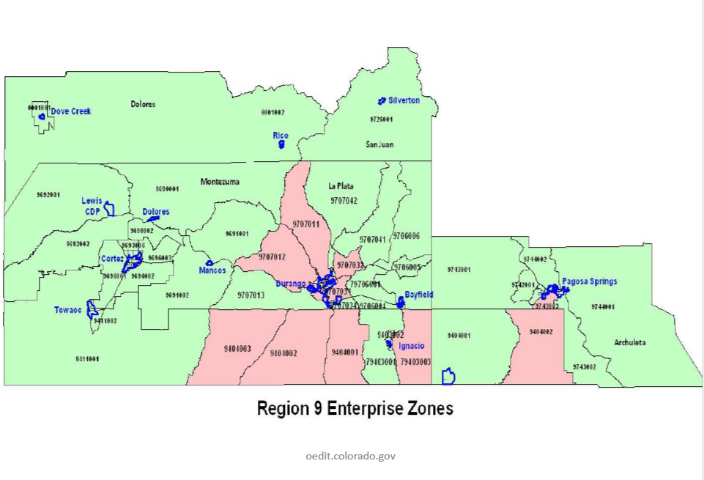

Slide 8
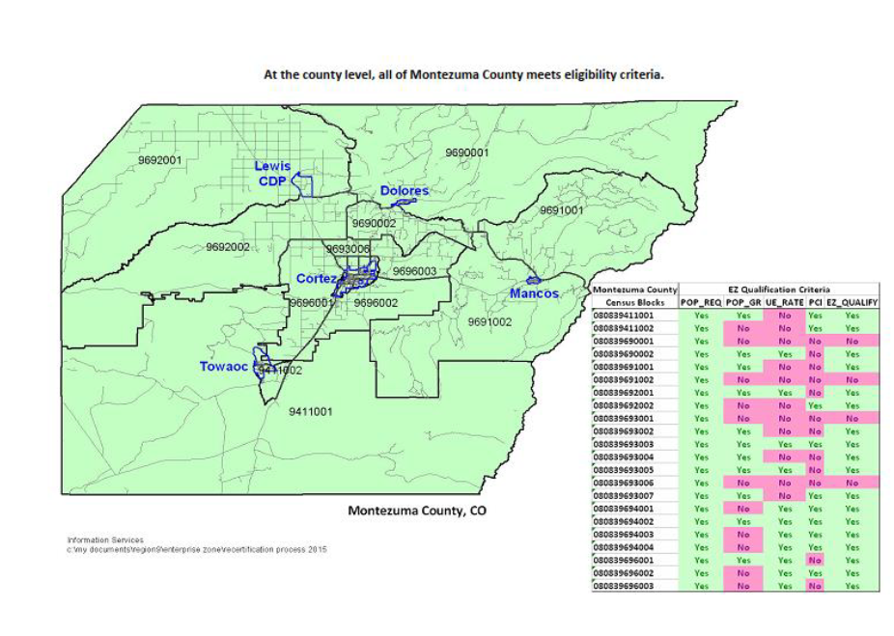

Slide 9
Tax Credits
EZ Tax Credit | Credit Amount
Investment Tax Credit | 3% of equipment (tangible personal property – i.e. computer)
Job Training Tax Credit | 12% of qualified expenses
Commercial Vehicle Investment Tax Credit | 1.5% of commercial vehicle purchases
New Employee Credit (full time) | $1,100 per new employee Additional $2,000 for EREZ Additional $500 for agricultural manufacturing or processing employee
Employer Sponsored Health Insurance Credit | $1,00 per employee covered during 1st two years in the EZ
R&D Increase Tax Credit | 3% of increase R&D expenditures
Vacant Building Rehab Credit (building must have been vacant for at least 2 years) | 25% of rehab expenditures (hard costs) up to $50,000
Sales & Use Tax Exemption for Manufacturing or Mining | Expands standard exemption for EZ businesses

Slide 10
Investment Tax Credits (ITC)
3% State Income Tax Credit on any qualified investment
All Section 38 property
  Depreciable tangible personal property (equipment, furniture, computers, etc.)
  Also includes: single purpose agricultural structures, oil pipelines, breeding livestock
  EXCLUSIONS: air conditioning, heating units, certain boilers, used equipment over $150,000, leased used equipment
Rolling Stock
  Vehicles need to be predominately housed and based in the EZ
Notes:
Milking parlor
Probably chickens

Slide 11
Commercial Vehicle ITC
1.5% Income Tax Credit on commercial vehicle purchase price
New commercial trucks, truck tractors, tractors, or semitrailers & associated parts
Gross vehicle weight rate of 54,000+ lbs
Designated Class A Personal Property C.R.S 42-3-106(2)(a)
Licensed and Registered in Colorado
Vehicles need to be predominately house and based in the EZ
Primarily fleets (if not truck)
Notes:
Company car? Better to put under investment tax credits

Slide 12
Job Training Credit
12% Tax Credit on job training expenses
Requirements:
  NOT employer to employee training (not on the job)
    to qualify for the job training credit, the business either brings in a trainer or sends employees to a training
  Includes: airfare, hotel, class fee, etc.
  Includes: salary of trainer
  Carry forward 12 years
Notes:
Restaurant brings someone in to talk about sanitzation
Business owners counts at this..

Slide 13
New Employee Credit
$3,100
$1,100 per new employee + $500 if agricultural business
  Additional $2,000 for EREZ
  Additional $500 for agricultural manufacturing or processing employee
  Credit goes to business, not employee
Calculating a “new” employee:
  Calculate by FT equivalent positions, not number of employees
  12 month average – accounts for seasonality/new positions
  Positions can only be count once for the credit
    If you have 15 positions already counted, can’t claim credit until position count increases to 16…etc
  7 Year Forward EREZ (5 Year Carry Forward (EZ)
$3,600

Slide 14
More about New Employees…
Part-time and seasonal employees count
  Must work at least 20 hours at the business
AVERAGE number of employees for the year (taken by the average employees every month and dividing by 12). For example
  January – April Company X employs 5 full time equivalent employees
  May – October Company X employs 10 full time equivalent employees
  November & December Company X employs 5 full time equivalent employees
    = 90 total employees / 12 = 7.5 for EZ Tax Credit
Notes:
Does business owner count? If getting salary

Slide 15
Employer Sponsored Health Insurance Credit
Available the first two full years in the EZ
Employers pays at least 50% of health insurance cost
Qualified health insurance plan
$1,000 per covered employee
Carry forward 5 years

Slide 16
Vacant Commercial Building Rehabilitation Credit
25% tax credit on eligible expenditures
Limited to $50,000 per building
Carry forward 5 years
May be claimed by owner or tenant (whoever pays for the rehabilitation)
QUALIFYING BUILDING | QUALIFYING EXPENDITURES
At least 20 years old | Hard costs of rehabilitating qualifying building
Completely vacant for at least 2 consecutive years | Not eligible: soft costs (engineering and planning, acquisition, fees, etc.)
Rehabilitation for commercial use
Notes:
(does that include apartments?) yes

Slide 17
Manufacturing Sales & Use Tax Exemption
Statewide -Machinery and machine tools used in manufacturing are exempt from State Sales & Use Tax
Form DR1191 must be provided to Colorado vendor
  Used “predominantly” in manufacturing process
  Section 38 Property
  At least $500 per invoice
  Capitalized
When machinery is used solely & exclusively in an EZ
  Includes machines and machine tools used in the extraction of natural resources
  Materials for construction or repair of machinery
  Non-capitalized machinery OK if expansion
MUST be purchased from a Colorado Vendor
Notes:
Coloraso bizbuying from another co biz….get permisiion to wqaive sales taxc…

Slide 18
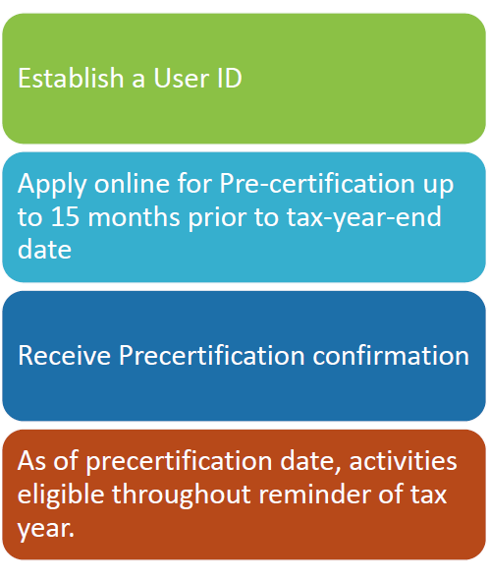
HOW TO ENROLL:
Pre-Certify your business
Region 9 EDD confirms business is in EZ
Conduct business
Certify EZ tax credits online & submit State income taxes
*must file electronically to earn EZ Tax credits!

Slide 19
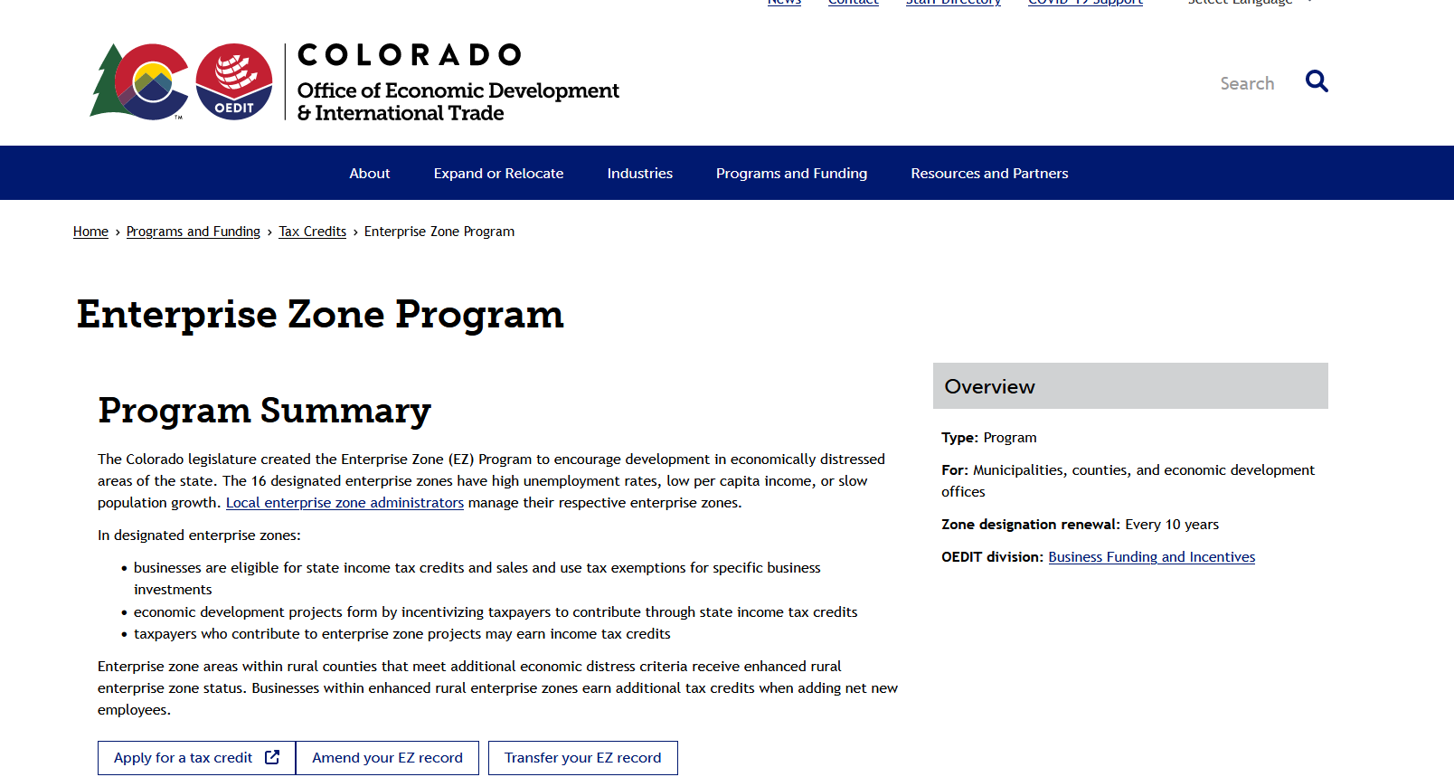

Slide 20
Precertification
REQUIRED each tax year prior to counting activities that may earn EZ credit
Must provide Tax ID and Location of business to be eligible
  Include business and any tax accountant info
Apply at: https://oedit.Colorado.gov/enterprise-zone-program
May apply up to 3 months before tax year starts (October) or 3 months prior to start of fiscal year
  Pre-Certification covers the approval date through the end of the tax year
  Your tax accountant can do this for you! CHECK with them!

Slide 21
Information Needed to Pre-Certify for EZ Tax Credits:
Business Address & Contact Information
Tax ID # / Tax Year
NAICS Code
Tax Preparer Contact Information

Slide 22
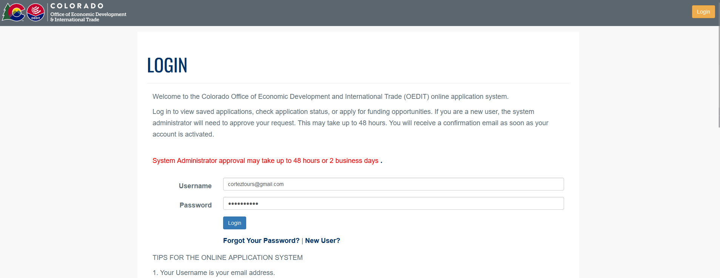

Slide 23
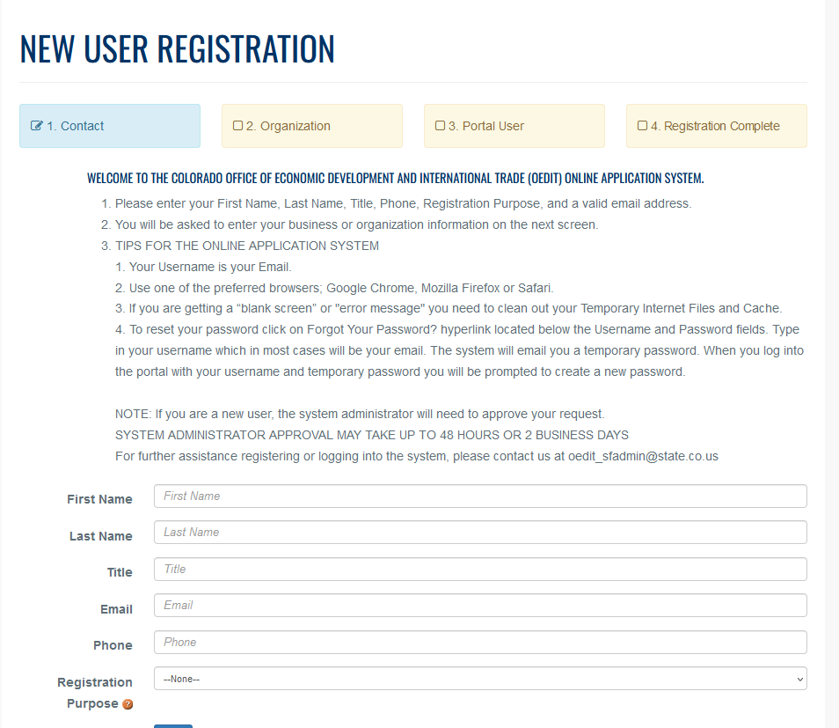

Slide 24
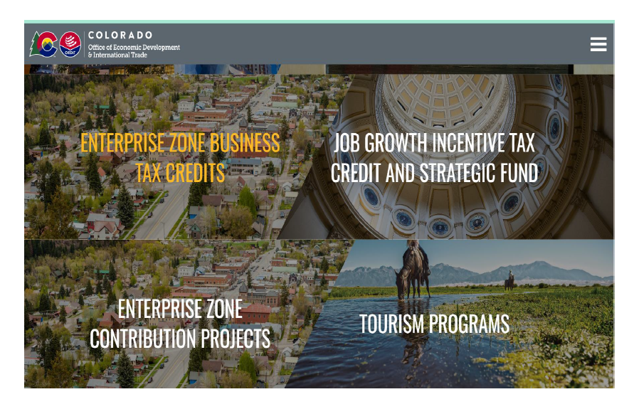

Slide 25
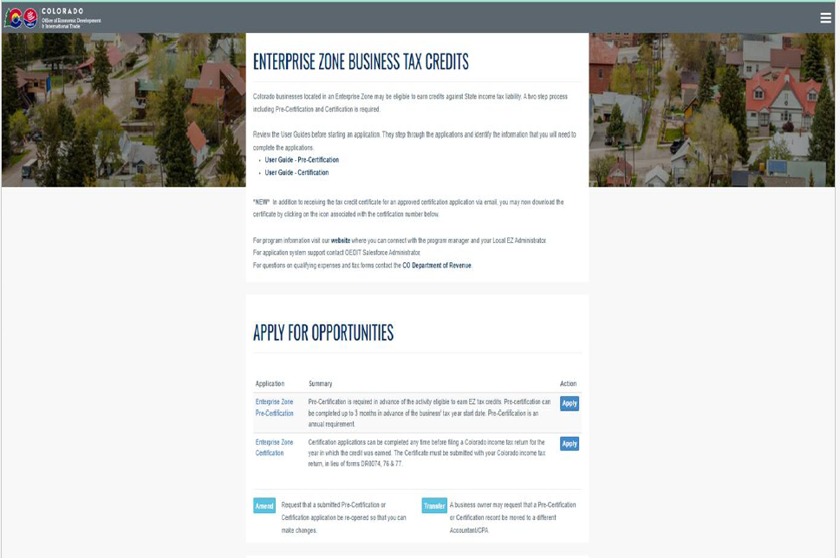

Slide 26
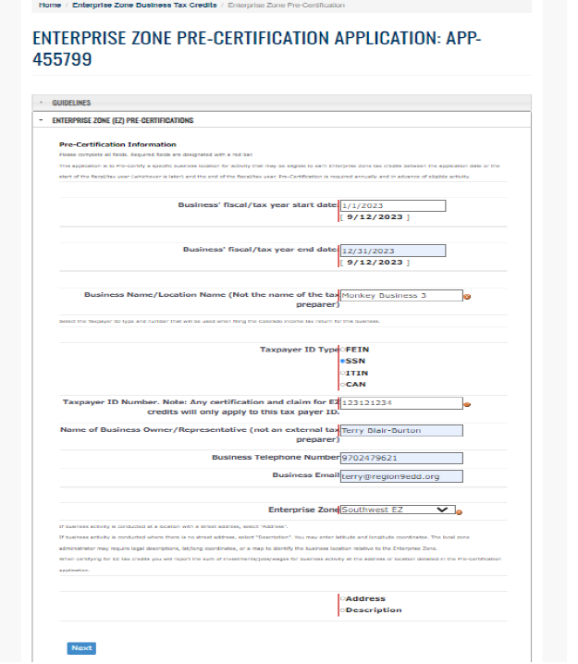

Slide 27
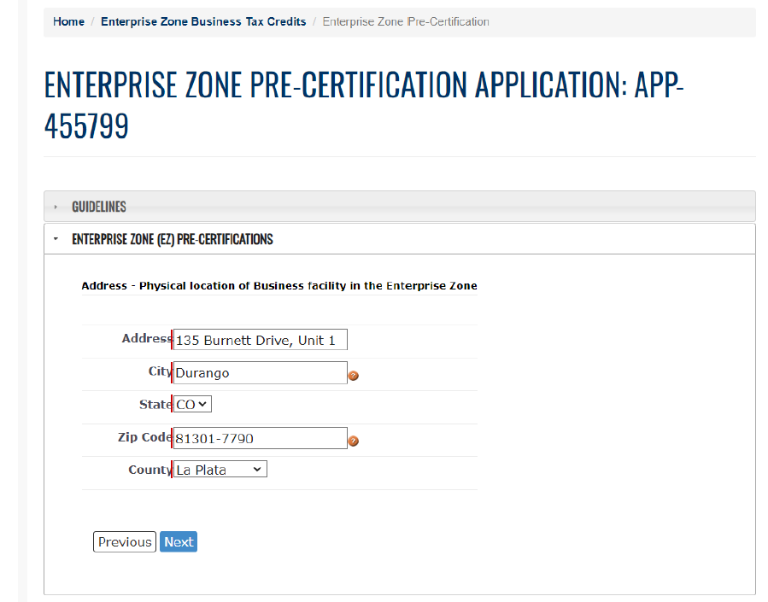

Slide 28
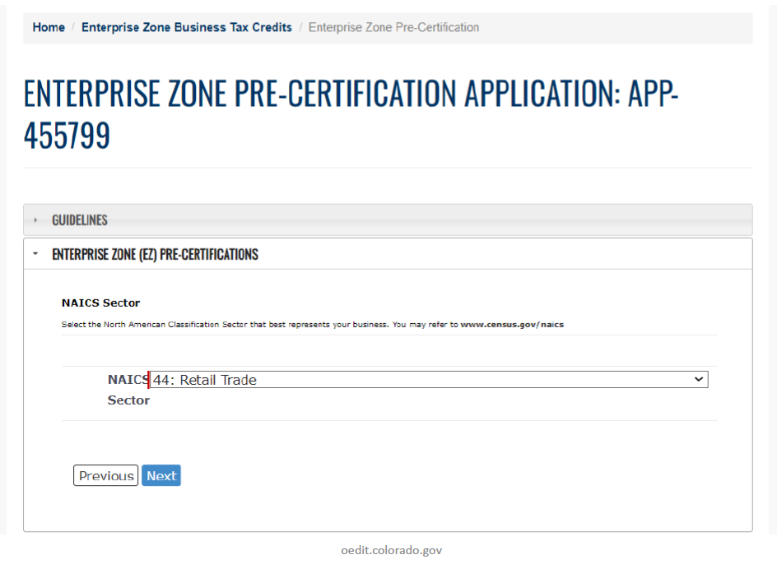

Slide 29
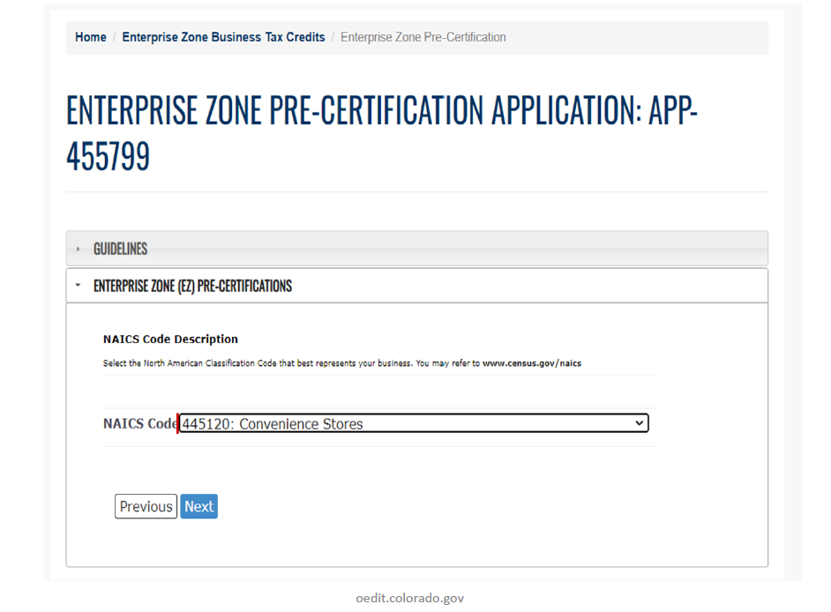

Slide 30
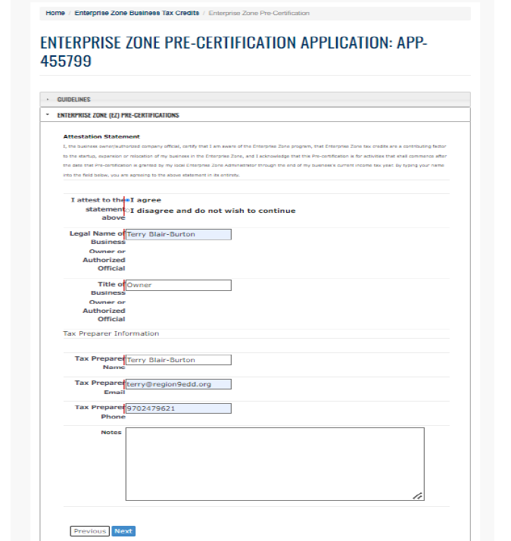

Slide 31
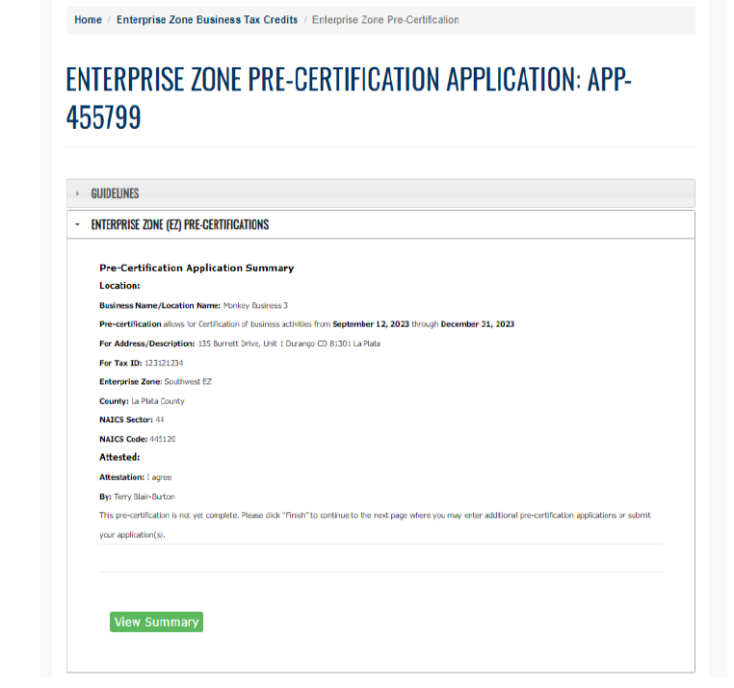

Slide 32
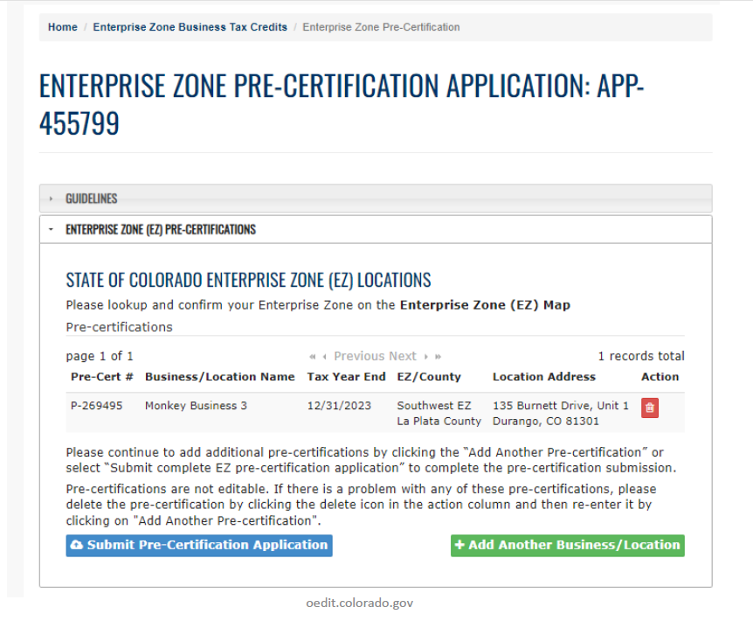

Slide 33
Certifying EZ Tax Credits
(after pre-certifying and at the end of the year)
After tax year, submit Certification for any and all tax credits earned.
  Click the Orange Certify Icon on the Pre-certification for the Tax Year
  Submit for approval
Region 9 certifies the entries and sends confirmation certificate to business.
Submit certification forms with your State tax returns.

Slide 34
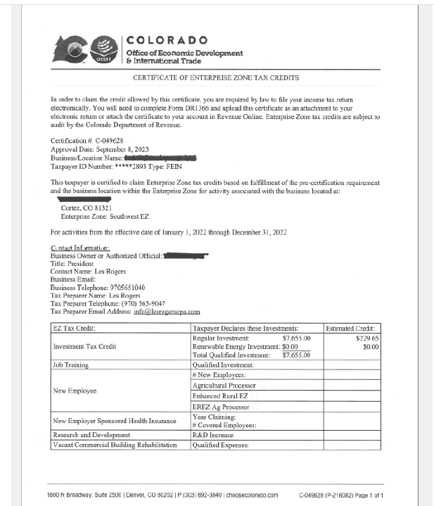

Slide 35
EZ Contribution Projects
Donor Tax Credits for Contributions made to State Approved Projects
Must be a non-profit organizations or government entity
Project must align with EZ Mission and EZ Regional Goals
Application to be a state approved projects requires local and statewide approval
25% EZ Tax Credit for Cash
12.5% EZ Tax Credit for In-Kind Donations
Notes:
(can biz get tax credits too?)
yep
(who sets?) ez goals – regional goals set by region 9 regional goals

Slide 36
State Approved EZ Contributions Projects in Montezuma County
Montezuma Heritage Museum,
Mancos Common Press
Crow Canyon Archaeological Center
Southwest Memorial Hospital Foundation
Habitat for Humanity of Montezuma County
Cortez Cultural Center
Axis Health Systems
Montezuma Food Systems Good Food Collective
Region 9 Economic Development District of Southwest Colorado
Southwest Colorado Accelerator Program for Entrepreneurs (SCAPE)
Southwest Small Business Development Center

Slide 37
State of Colorado
https://oedit.colorado.gov/enterprise-zone-program
Che Sheehan – Office of Economic Development & International Trade
che.sheehan@state.co.us
Southwest Enterprise Zone Administrator
https://www.region9edd.org/enterprise-zone
Terry Blair-Burton – Region 9, Program Administrator Enterprise Zone
970-247-962
terry@region9edd.org
City of Cortez
https://www.cortezco.gov/892/Enterprise-Zone-Business-Tax-Credits
Helen West – City of Cortez, Community & Economic Development
970-331-0213
hwest@cortezco.gov

